Slide 1
Setup

Slide 2
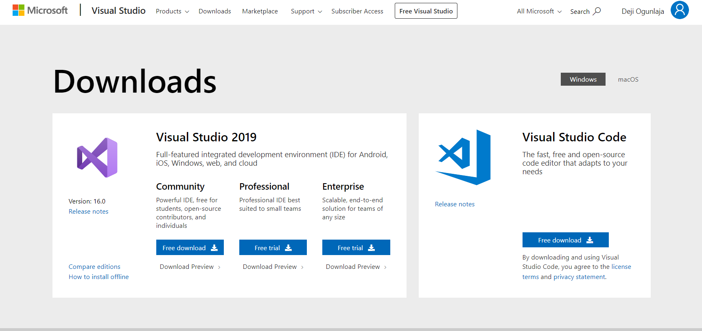
Install Visual Studio
https://visualstudio.microsoft.com/downloads/
Click Download on Community

Slide 3
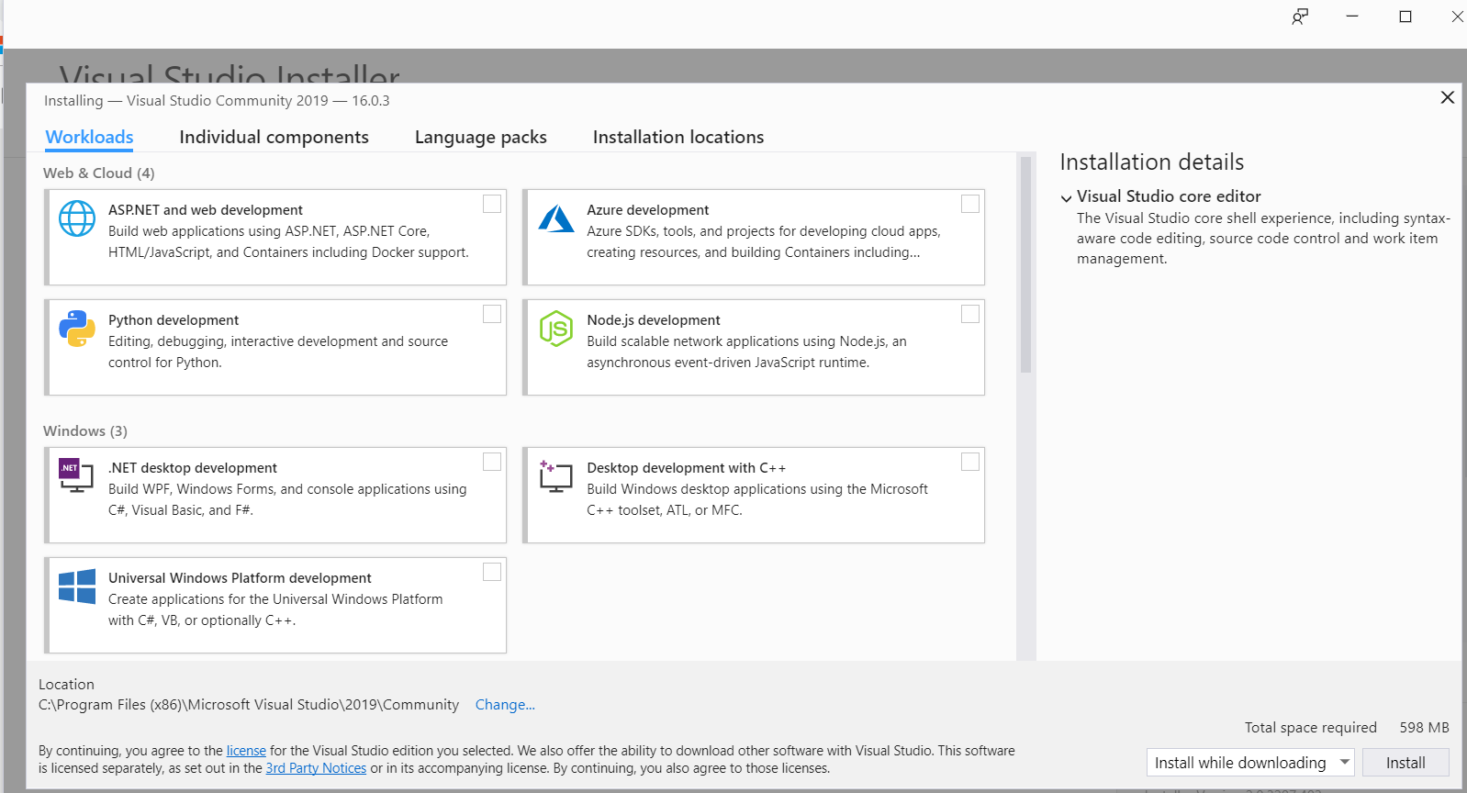
Select Install while downloading
Click Install

Slide 4
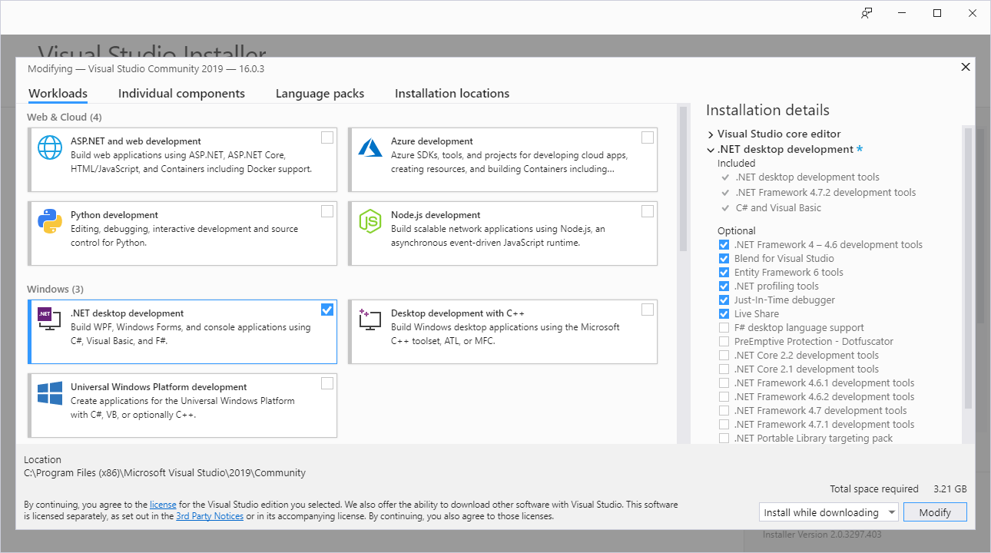

Slide 5
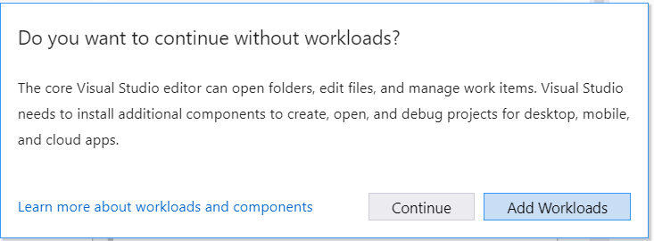
Click Add Workloads

Slide 6
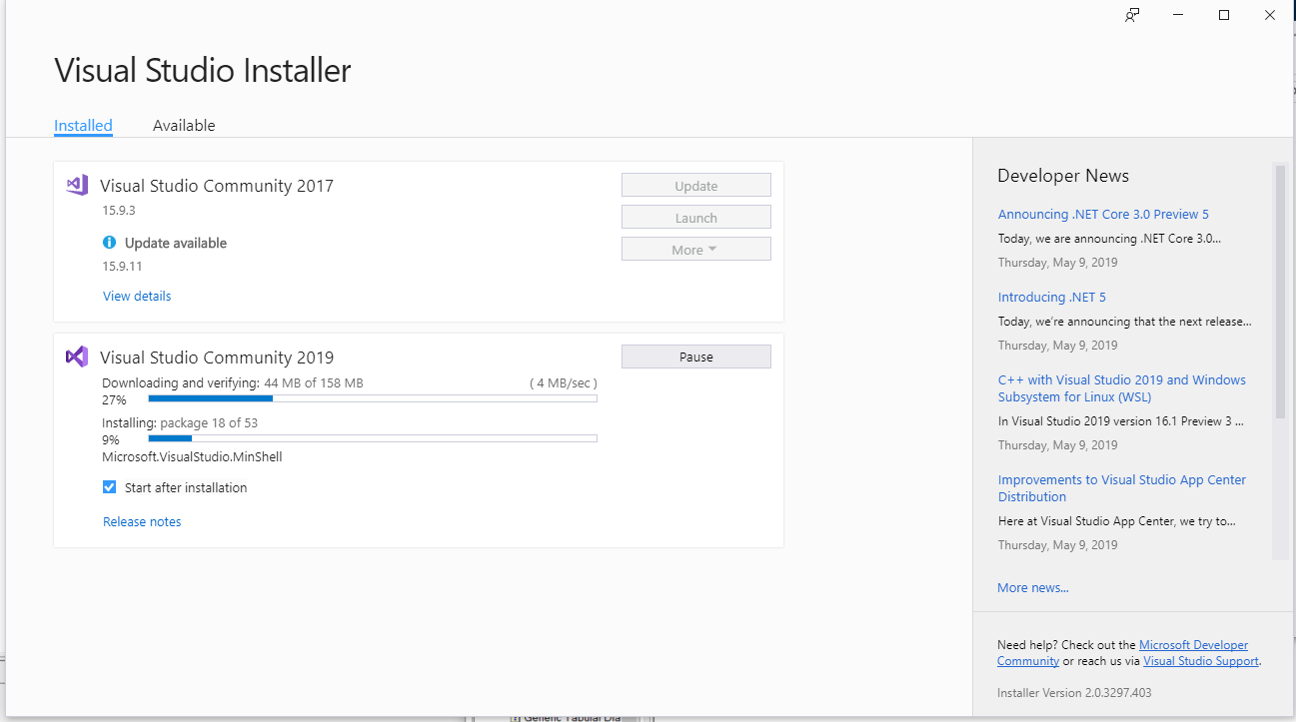

Slide 7
Install Windows AppDriver

Slide 8
http://appium.io/docs/en/drivers/windows/
https://github.com/Microsoft/WinAppDriver

Slide 9
Install Windows SDK (Optional)
https://developer.microsoft.com/en-us/windows/downloads/windows-10-sdk

Slide 10
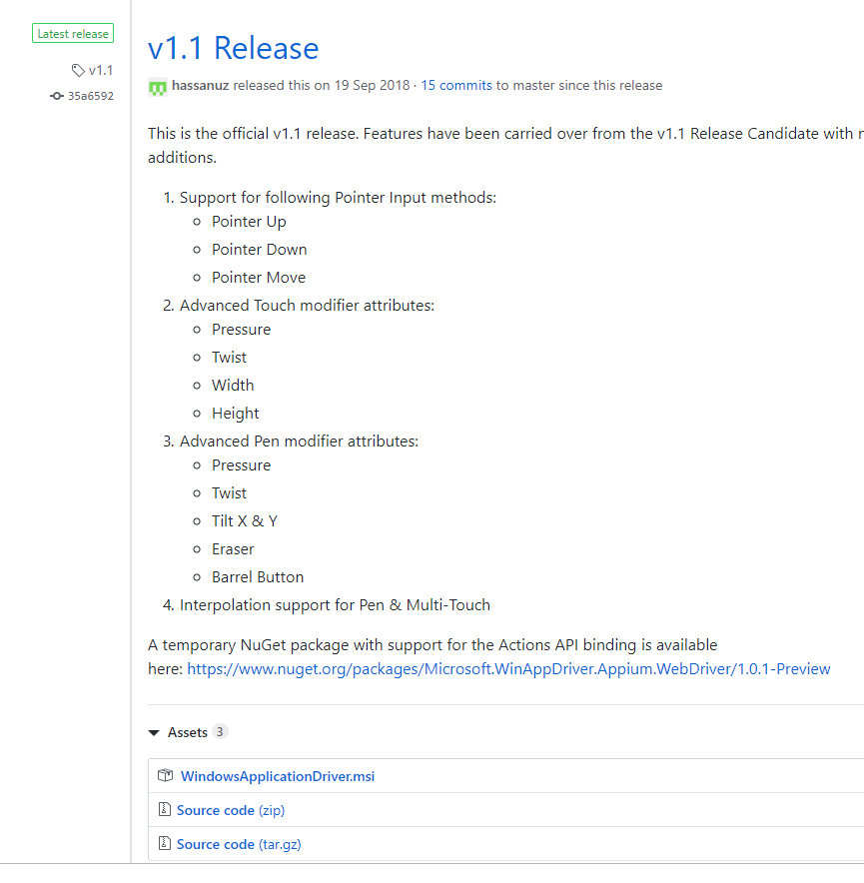
Go to https://github.com/Microsoft/WinAppDriver/releases
Click on the recent stable release eg
Download the MSI
And install

Slide 11
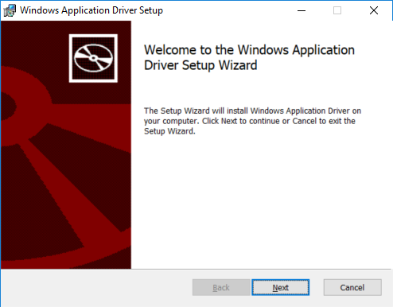

Slide 12
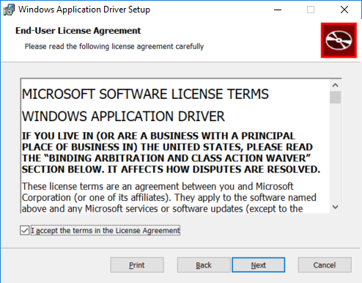

Slide 13
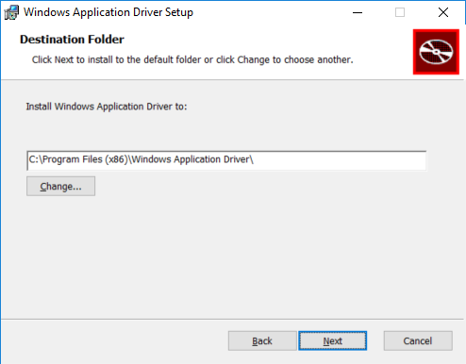

Slide 14
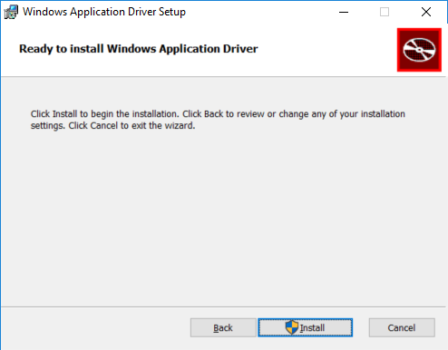

Slide 15
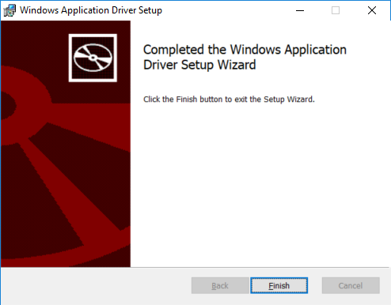

Slide 16
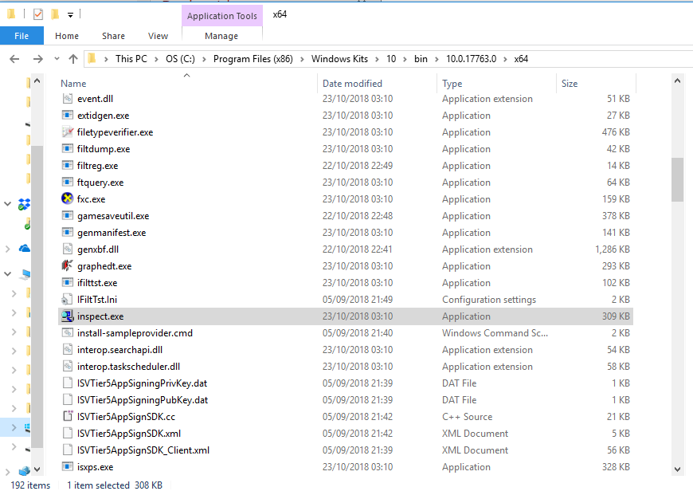
Start the Inspect tool
Open the file C:\Program Files (x86)\Windows Kits\10\bin\10.0.17763.0\x64\inspect.exe

Slide 17
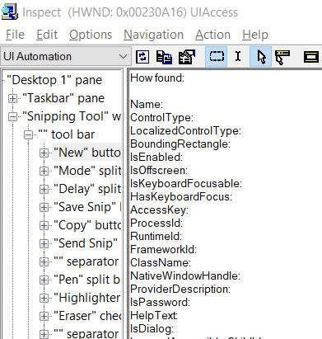

Slide 18
Start the remote driver
C:\Program Files (x86)\Windows Application Driver\WinAppDriver.exe

Slide 20
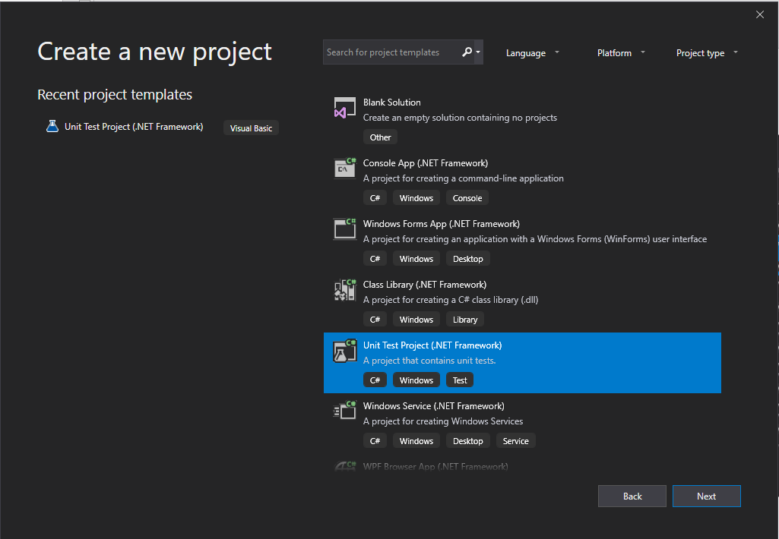
Create a new Project
Open Visual Studio
Click File
Click New
Select Unit Test Project (.NET Framework) as template to use for C#
Make sure it is the C# unit test project
Click Next

Slide 21
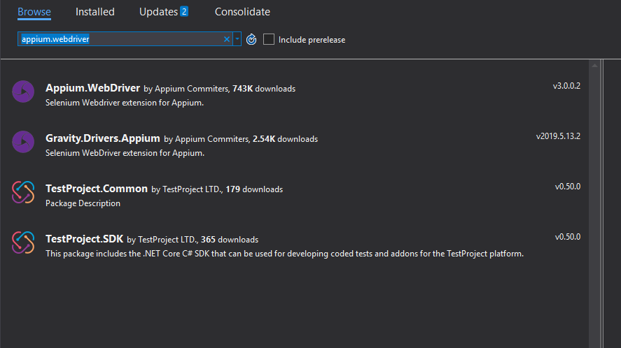
Add Appium.WebDriver to the Nugget Package

Slide 22
